Slide 1
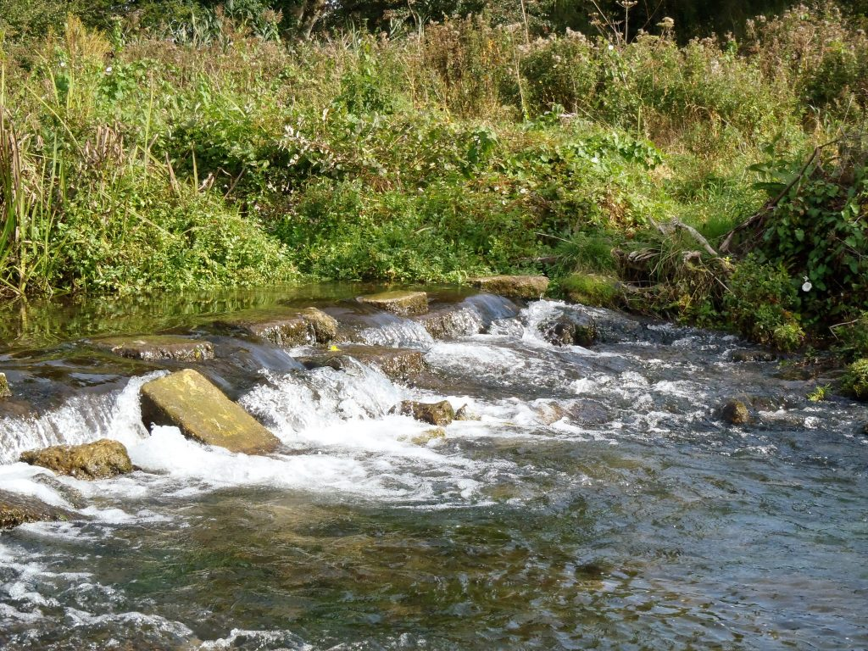
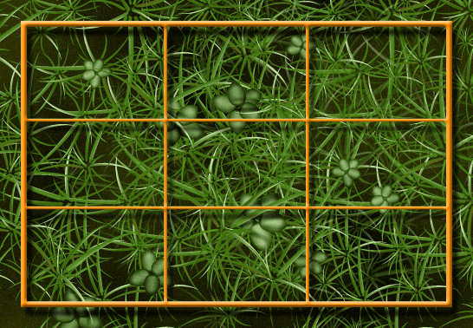
Sampling Techniques
Amieroh Abrahams 3559244 • Kylen Brown 3540337 • Kim Scholtz 3571589
University of the Western Cape
Notes:
<number>

Slide 2
Introduction
Ecology is the study of relationships between living things and their environment
3 Components of ecological studies
Ecological methods address a wide range of scales and are concerned with the acquisition of data on individual organisms, single populations and entire ecosystems
Programme planning
Field data acquisition
Data analysis

Slide 3
Sampling methods
Stratified sampling
Random sampling
Systematic sampling
Belt transects
Line transects

Slide 4
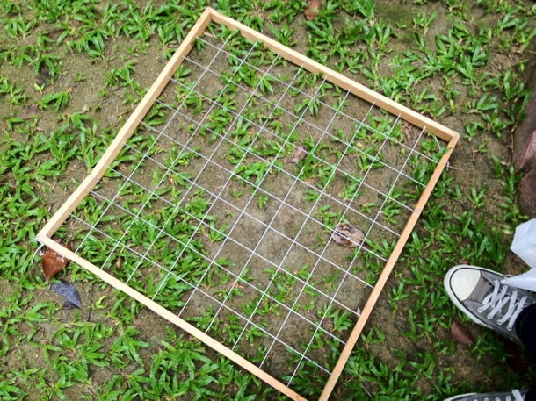
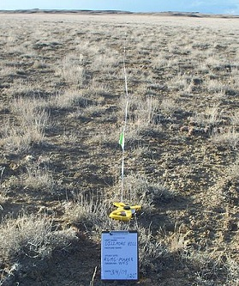
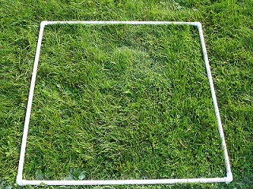
Sampling methods
Line and belt transects
A transect line is laid along an environmental gradient and samples are taken at predetermined intervals
Belt transects are similar to line transects but they allow for a greater area of sampling
Quadrats
- Used to measure coverage and abundance of plants and animals

Slide 5
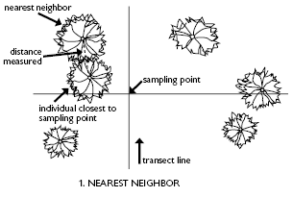
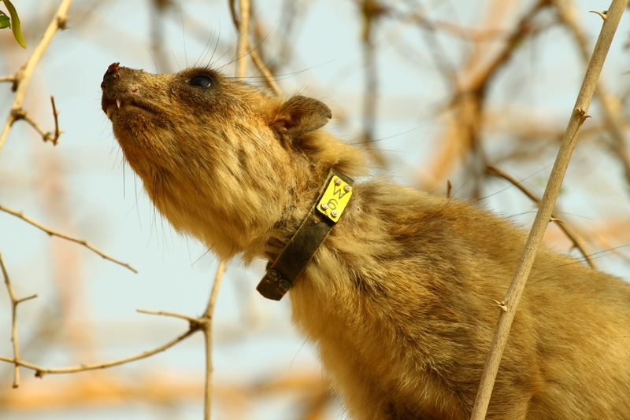
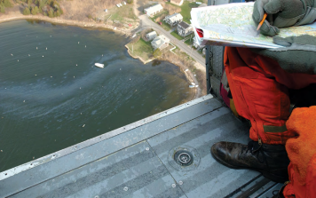
Sampling methods
Plotless techniques
One of the plotless techniques is the nearest-neighbour method
Plotless methods use distances between a point
Lincoln index
Mark and recapture methods
Used for smaller animals
Aerial observations
Used when observing large trees and animals

Slide 6

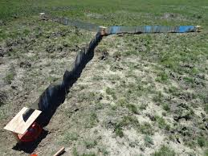
Sampling methods
Spatial sampling
Collect samples in 1-, 2-, 3-dimensional space
Used to estimate the total or mean for a parameter in an area
Pitfall trap arrays
Pitfall traps consist of some type of container that is sunk into the ground, with the rim level with the surface
Animals that fall into pitfalls are unable to climb out, becoming trapped

Slide 7
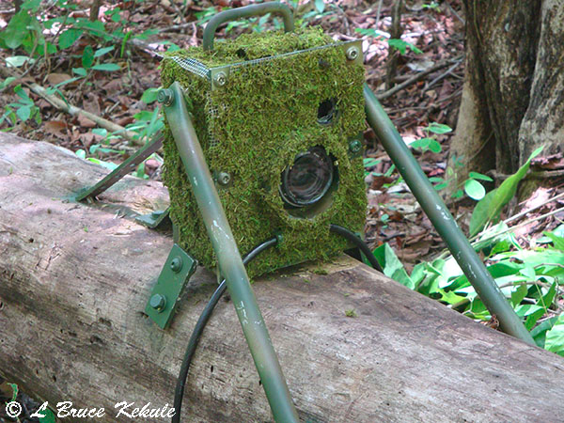
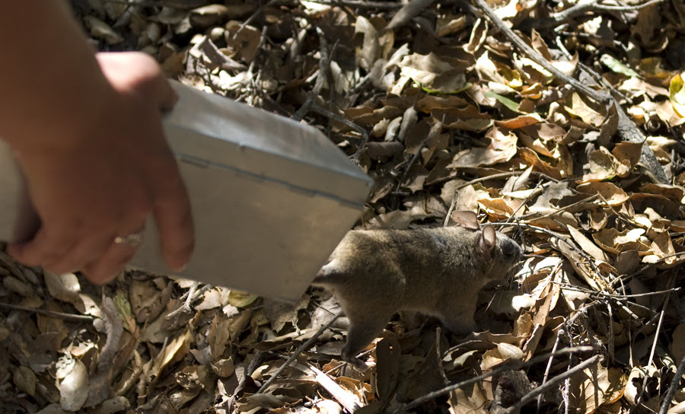
Sampling methods
Camera traps
Used to observe the behaviour of animal populations
Live trapping or tagging
Common reasons to capture mammals include live trapping to tag, mark or for tissue collection

Slide 8
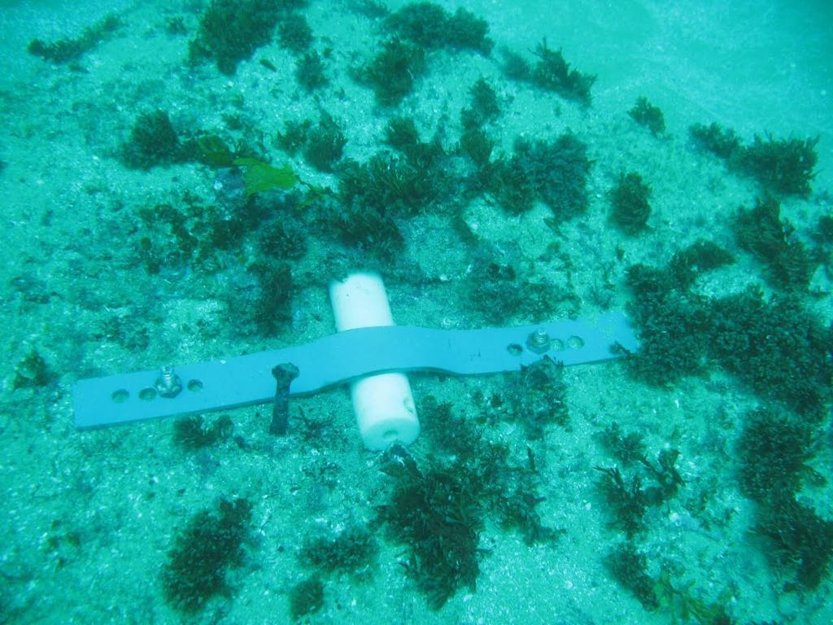
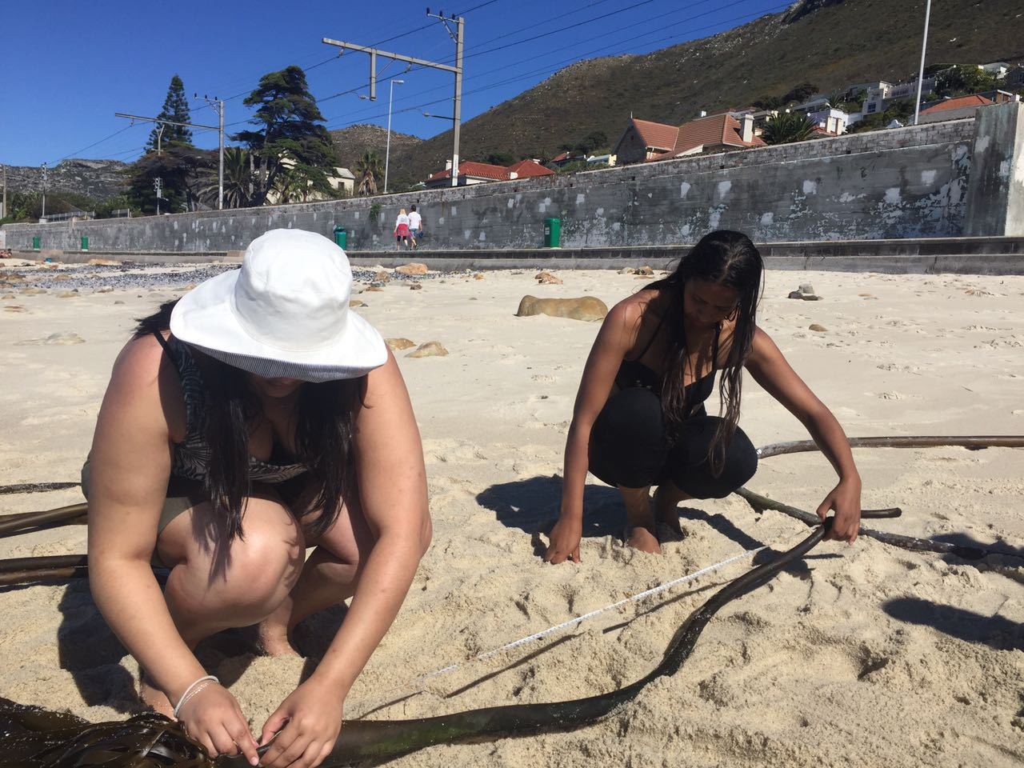
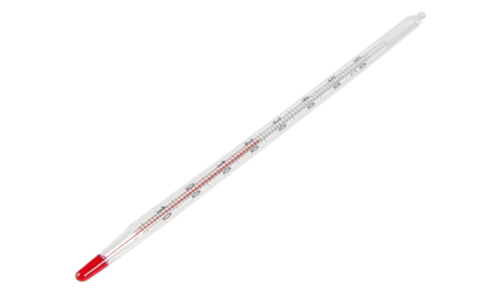
Examples of sampling techniques
Underwater temperature recorders to record the temperatures at a specific location
Thermometers used to record in situ temperature measurements

Slide 9
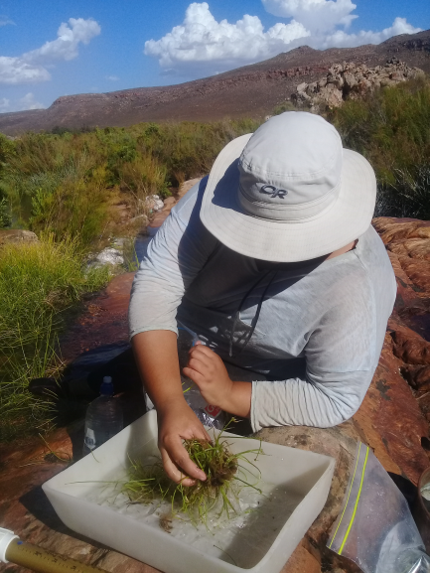
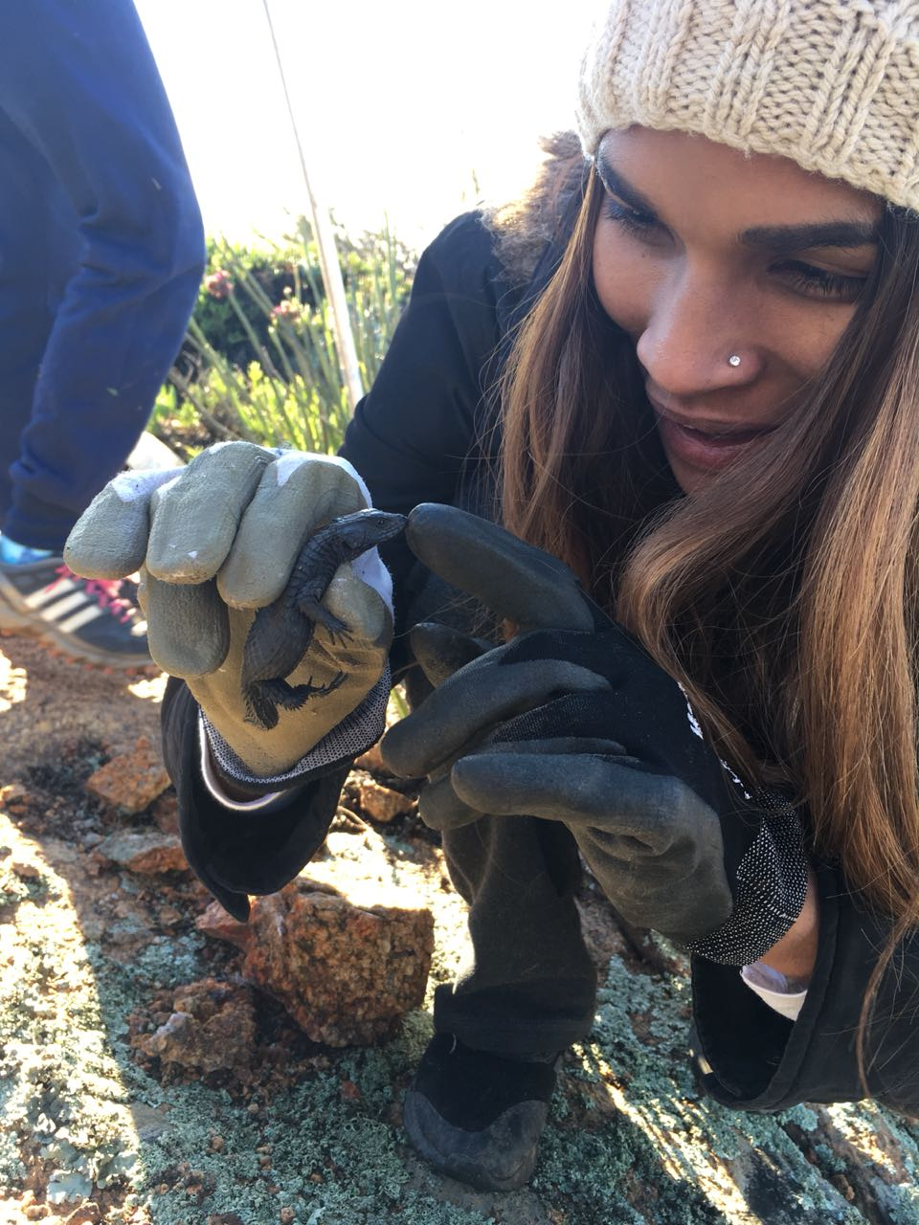

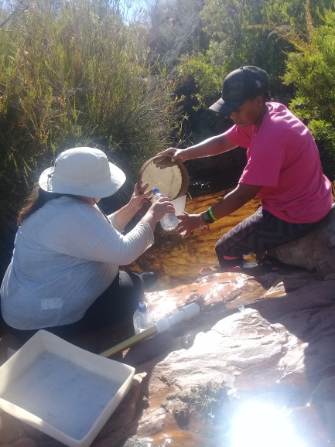
Examples of sampling techniques

Slide 10

Thank you

